Slide 1
A re-reserving algorithm to derive the 1-year reserve risk view
15th July 2013, London – CASS Business School
Alessandro Carrato, Fully Qualified Actuary
Istituto Italiano degli Attuari / Ordine Nazionale degli Attuari

Slide 2
The application in a nutshell …
At the moment it is a (heavy) mod of the glmReserve.R library (by Zhang) of the Chain Ladder R package, not yet compiled in the main package
It’s currently available to public at the following web address: http://code.google.com/p/chainladder/source/browse/branches/alessandro/R/StochasticReserving.R
TWO MAIN PURPOSES
Improves the MODEL ERROR understanding for the Reserve Risk, in a Solvency 2 framework
It provides an estimation of the 1 year Reserve Risk view through a re-reserving approach, useful for internal models

Slide 3
Contents
  Introduction
  Reserve Risk: assessing the Model Error
  Reserve Risk: assessing the “1yr view”

Slide 4
Solvency II: a Three-Pillar Structure
Three Pillars Approach
PILLAR 1
Quantitative capital requirements
Quantitative Risk Management
PILLAR 2
Qualitative requirements & supervision
Qualitative Risk Management
PILLAR 3
Transparency
Disclosure
Three Pillars Approach is applied both at Company and at Group level
Assets and Liabilities Valuation
Risk quantification
  Minimum capital requirement (MCR)
  Solvency capital requirement (SCR)
Market value based own funds
Governance System
  Organisational structure
  Risk Management
  Actuarial function
Internal control system
ORSA
Use Test
Market information
  Business overview and performances
  Governance
  Evaluation criteria
  Risk and Capital Management
Supervisory reporting
There are a lot of interdependencies between the different tasks within
the different pillars

Slide 5
Risk Capital
SCR.1.9 The SCR (Solvency Capital Requirement) should correspond to the Value-at-Risk of the basic own funds of an insurance undertaking subject to a confidence level of 99.5% over a one-year period
distribution of NAV
after one year
LIABILITIES
expectation = best estimate
ASSETS
ASSET
VOLATILITY
(market development)
OWN
FUNDS
(NAV)
solvency standard
worst case
default probability
0
So, everything that affects the own funds in the next 12 months should be considered as a risk

Slide 6

Risk Capital
Being the risk represented by the uncertainty of the future NAV development, this can be split into several categories, corresponding to the events giving place to the possible NAV variations
Risks Universe
P&C
Insurance
Life
Insurance
Market
Credit
Business
Operational
Other
Equity
Counterparty
Premium
Non Cat
Mortality
Cost
Operational
Reputational
Real Estate
Premium
Nat Cat
Longevity
Lapse
Compliance
Strategic
Foreign Exch.
Premium Man
MadeCat
Disability
Legal
Financial
Reporting
Interest Rate
Reserve
Catastrophe
Liquidity
Volatility
Capital Adequacy
Solvency Risk
Credit Spread

Slide 7
Contents
  Introduction
  Reserve Risk: assessing the Model Error
  Reserve Risk: assessing the “1yr view”

Slide 8
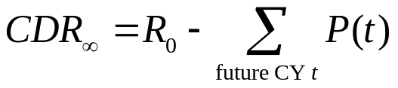
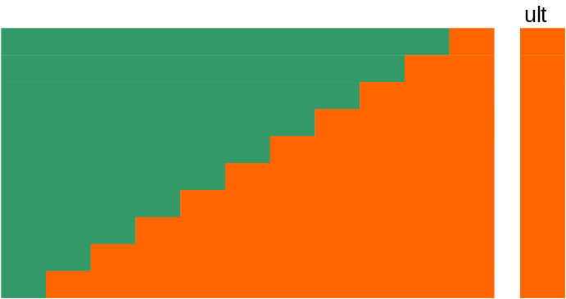
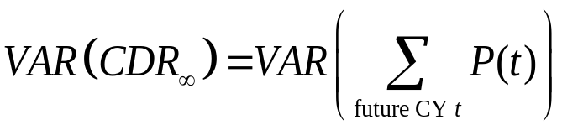
Reserve Risk
SCR.9.11 Reserve risk results from fluctuations in the timing and amount of claim settlement
Run off shock
In order words, it’s like if we simulate the fact we are at the end of the reserve run-off and we observe how wrong we were at the instant of evaluation

Slide 9
Risk Capital
Step 1: Assessment of nature, scale and complexity of risks
SCR.1.19 The insurer should assess the nature, scale and complexity of the risks […]
This includes parameter, process and model errors …
Step 2: Assessment of the model error
SCR.1.21 Where simplified approaches are used to calculate the SCR, this could introduce additional estimation uncertainty (or model error) […]
SCR.1.23 Undertaking are not required to quantify the degree of model error in quantitative terms […] Instead, it is sufficient if there is reasonable assurance that the model error included in the simplifications is immaterial
… but if model error is “immaterial”, we aren’t required to quantify it …

Slide 10
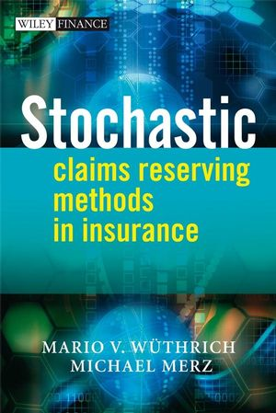
Reserve Risk
Tons of studies in actuarial literature regarding the Stochastic Loss Reserving

Slide 11
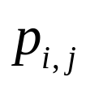

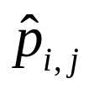
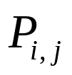
Reserve Risk – The underlying models
There is a “change of perspective” compared with the past
DETERMINISTIC MODELS
STOCHASTIC MODELS
 | DY j
AY i | 1 | 2 | 3 | 4 | … | j | … | J
0
1
…
…
i
…
…
I-1
I
 | DY j
AY i | 1 | 2 | 3 | 4 | … | j | … | J
0
1
…
…
i
…
…
I-1
I
known incremental paid claims
random variables, with known value
obtained with deterministic model
random variables

Slide 12
Reserve Risk – The underlying models
In order to use stochastic model, you need to fix stochastic assumptions
Assumptions
Example
  PARAMETRIC
Give the parametric distribution family of
  GLM
  SEMIPARAMETRIC
Give only some assumptions on some moments
  MACK
Usually the market is now considering mainly two stochastic models (ODP & Mack model), that have the Chain Ladder as underlying BE …
But if the Chain Ladder isn’t working … what about the model error?
Please note that – actually – stochastic models based on DFM selection don’t have a proper stochastic underlying model

Slide 13
Reserve Risk – Assessing the Model Error
Idea: give as much flexibility as possible!!
Other than Tweedie(power) family and link function …
design.type
(*)
  Possibility to change the GLM design matrix, considering Origin Year (OY), Development Year (DY) and Calendar Year (CY) e.g. ODP has a Y ~ as.factor(OY) + as.factor(DY)
  Possibility to model as.factor or as.number
bootstrap
(param error)
  Parametric bootstrap (rtweedie generation of pseudodata)
  Semi-parametric bootstrap (i.e. residual resampling)
proc.error
  Derive process error through a proper rtweedie random number generation, coherent with specified model
p.optim
  Find the max likelihood estimate of the Tweedie’s p parameter
boot.adj
  Change the adj made in case of negative generated pseudo-data
(*) See Gigante, Sigalotti (2005) – Model Risk in Claims Reserving with GLM [Journal of Istituto Italiano degli Attuari, Vol. LXVIII, pp.55-87]

Slide 14
Contents
  Introduction
  Reserve Risk: assessing the Model Error
  Reserve Risk: assessing the “1yr view”

Slide 15
Reserve Risk - Where are the problems?
Let’s give a look again to the definition of SCR
SCR.1.9 The SCR (Solvency Capital Requirement) should correspond to the Value-at-Risk of the basic own funds of an insurance undertaking subject to a confidence level of 99.5% over a one-year period
So, in 2008, the IAIS(*) published the following interpretation:
“ […]
Shock period: the period over which a shock is applied to a risk;
Effect horizon: the period over which the shock that is applied to a risk will impact the insurer
In essence, at the end of the shock period, capital has to be sufficient so that assets cover the technical provision (…) re-determined at the end of the shock period. The re-determination of the technical provisions would allow for the impact of the shock on the technical provisions over the full time horizon of the policy obligations”
(*) International Association of International Supervisors
Guidance paper No. 2.1.1 on the structure of regulatory capital requirements (October 2008), Art. 55
http://www.iaisweb.org/view/element_href.cfm?src=1/5778.pdf

Slide 16

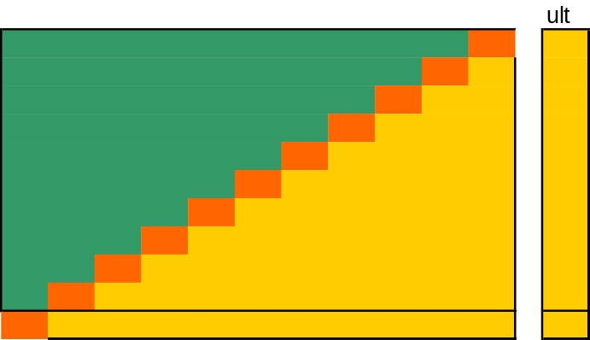




All the models seen until now consider a “shock” until the full reserve run-off (the so called “Ultimate View”)
“Ultimate view”
“1y view”
The “1-yr view” concept was born!!

Slide 17
Reserve Risk - The “1yr View”
From 2008, mainly two papers have been published on the topic
Merz, Wuthrich (June 2008) - Modelling the Claims Development Result for Solvency Purposes (ASTIN)
Based on Mack (1993) assumptions + additional assumptions (martingale process)
No tails considered
Closed form for MSEP calculation (no information on the tails)
Consider both a “perspective” and retrospective view
Starting from QIS5 it has been officially recognized for the calculation of the USP (Undertaking Specific Parameters), to be used thru a credibility approach with the market parameters

Slide 18

Reserve Risk - The “1yr View”
Ohlsson, Esbjorn, Lauzeningks (2008) - The one-year non-life insurance risk
Gives only the general idea on how the one-year view should be evaluated (i.e. implementing the re-reserving algorithm – the so called “actuary in the box”)
If we consider as re-reserving algorithm only the CL, we get the previous Merz-Wuthrich approach
“1y view”
This approach is particular interesting for the internal model implementation; anyway, in these last years, not many studies in actuarial literature have been done: there are still a lot of open issues to be deepen

Slide 19
Reserve Risk – The “1yr View”
My idea is: “If I have an actuary that has parameterised the Ultimate View somehow in t=0, likely after 1-yr he will keep the same GLM parameterisation, but updating the state of information in t=1 with the next year simulated diagonal”
In other words:
For every diagonal simulated in the previous step, run again the GLM as parameterized in t=0
New function arguments
rereserving
  If TRUE, the model find the new ultimates after 1yr, simply running the same GLM parameterised in the Ultimate View, but adding the simulated diagonal related to the next year

Slide 20
The final slide ☺
FINAL CONSIDERATIONS
I tested the function several times, and it seems to don’t have critical issues
The are still minor tweaks to be done (e.g. extrapolation of future CY factors for particular design matrix specifications)
.. other than I have further ideas to implement!
Feel free to use it .. I’ll look forward to your feedback ☺

Slide 21
Q&A … and …
Thank you for your attention
fdfdf

Slide 22
Main References
[1] EIOPA (2012) Technical Specifications for the Solvency II valuation and Solvency Capital Requirements calculations [SCR 1.23, p. 119]
[2] Gigante, Sigalotti (2005) Model Risk In Claims Reserving with GLM [Giornale Istituto Italiano degli Attuari LXVIII, n. 1-2, pp. 55-87, 0390-5780]
[3] Merz, Wüthrich (2008), “Modelling CDR for Solvency purposes” [CAS E-Forum, Fall 2008, 542-568]
[4] Ohlsson et al. (2008), “The one-year non life insurance risk” [ASTIN Colloquia 2008]
[5] Wüthrich, Merz (2008), “Stochastic Claims Reserving Methods in Insurance” [The Wiley Finance Series]
<number>
Adding Value through Risk Management in P&C

